Slide 1
Smart Parking System
BY- RIBHU SHARMA
SHUBHAM JAIN
ADITYA JAIN

Slide 2
OVERVIEW
Moving towards smart city application, smart parking is a good example for a common citizen of how the Internet-of-Things (IOT) will be effectively and efficiently used in our daily living environments to provide different services to different users. Any citizen may use his mobile device, a computer having Internet to access the smart city application from anywhere in the world to find a free parking spot in the city and get to know that which parking spot is available. For IOT implementation Arduino is used.

Slide 3
Why Smart Parking?
Traffic congestion caused by vehicle is an alarming problem at a global scale and it has been growing exponentially. Car parking problem is a major contributor and has been, still a major problem with increasing vehicle size in the luxurious segment and confined parking spaces in urban cities. Searching for a parking space is a routine (and often frustrating) activity for many people in cities around the world. This search burns about one million barrels of the world’s oil every day. As the global population continues to urbanize, without a well-planned, convenience-driven retreat from the car these problems will worsen.

Slide 4
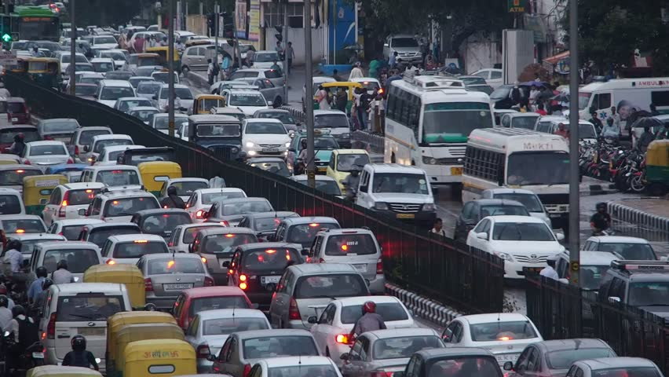
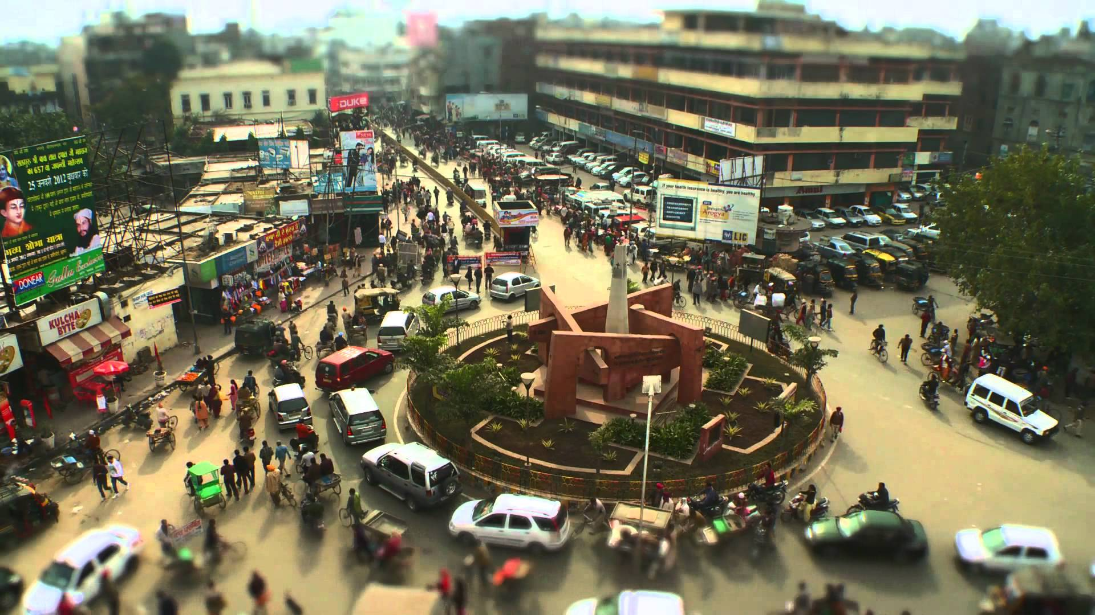

Slide 5
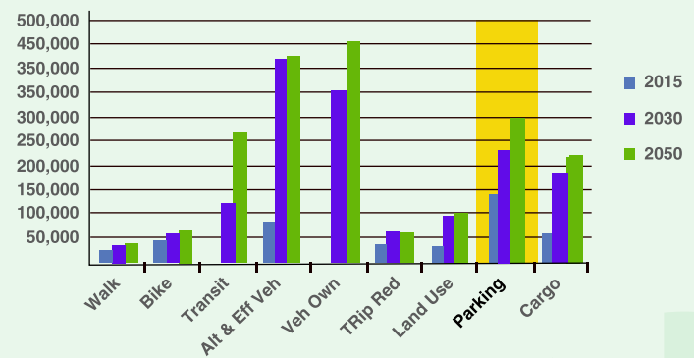
According to a report, Smart Parking could result in 2,20,000 gallons of fuels saving till 2030 and approx. 3,00,000 gallons of fuels saved by 2050 , if implemented successfully.

Slide 6
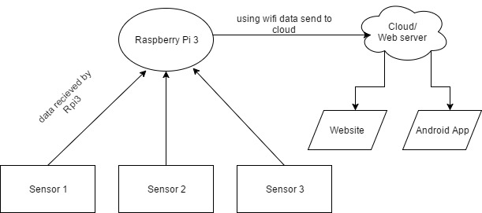
Model
ARDUINO

Slide 7
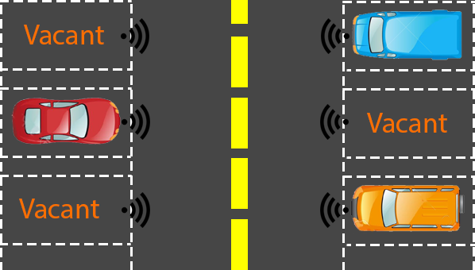

Slide 8


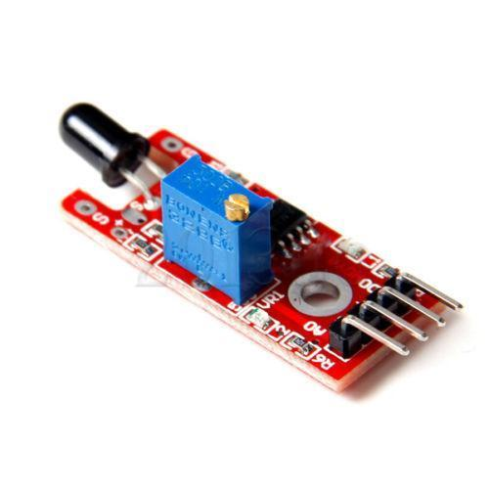
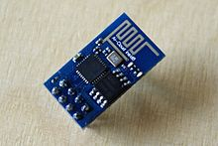
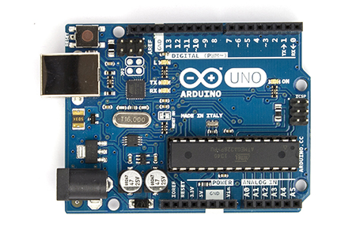
Components
1.) Arduino UNO 2.)IR Sensor 3.)ESP8266-01

Slide 9
Software Required
Arduino IDE
Web Server
Android Studio

Slide 10
Advantages
1.)Real Time Monitoring
2.)User Friendly
3.)Reduce Traffic
4.)Up to Date

Slide 11
Future Work
1.)Slot Booking System – User allotted with a fixed time.
2.)Automatic navigation System.
3.)Can be extended to a company parking system giving the best slot for parking a particular vehicle.

Slide 12
End Products/Conclusion
1.)A model visualizing parking slots.
2.)An android app displaying related information.

Slide 13
Thank You ☺

